Slide 1
Digital Portfolio
STUDENT NAME: Sameera Fathima M
REGISTER NO AND NMID: asunm1451222407520
DEPARTMENT: B.Sc.Computer Science
COLLEGE: COLLEGE/ UNIVERSITY Mahalashmi Women’s College of
Arts and Science , Madras University.

Slide 2
PROJECT TITLE
Digital portfolio

Slide 3


AGENDA
Problem Statement
Project Overview
End Users
Tools and Technologies
Portfolio design and Layout
Features and Functionality
Results and Screenshots
Conclusion
Github Link
3/21/2024 Annual Review

Slide 4

PROBLEM STATEMENT
Create a digital portfolio that effectively showcases my skills, experience, and accomplishments in computer science. The portfolio should be visually appealing, easy to navigate, and demonstrate my expertise in areas such as software development, data analysis, and problem-solving. It should also be adaptable to different audiences, including potential employers, clients, and collaborators. The goal is to create a professional online presence that highlights my strength.

Slide 5

PROJECT OVERVIEW
. This digital portfolio project aims to create a professional online platform showcasing my skills, experience, and accomplishments in computer science. The portfolio will feature a curated selection of projects, including software development, data analysis, and problem-solving initiatives. It will be designed with a user-friendly interface, easy navigation, and visually appealing graphics. The portfolio will serve as a dynamic representation of my expertise and adaptability, catering to various audiences such as potential employers, clients, and collaborators. Through this project, I aim to demonstrate my technical skills, creativity, and ability to effectively communicate complex ideas.

Slide 6

WHO ARE THE END USERS?
. The primary end-users of this digital portfolio are potential employers, clients, and collaborators in the tech industry. These individuals will be looking for evidence of my technical skills, experience, and accomplishments in computer science. They may include hiring managers, recruiters, project managers, and business owners seeking to assess my fit for job opportunities, freelance projects, or partnerships. Additionally, academic institutions and research organizations may also be interested in reviewing my portfolio to evaluate my expertise and potential for collaboration or further eductional.

Slide 7

TOOLS AND TECHNIQUES
. To create and maintain a digital portfolio, various tools and techniques can be employed. Some popular tools include website builders like WordPress, Wix, or Squarespace, as well as platforms specifically designed for portfolios like Behance or GitHub Pages. Techniques may involve designing a visually appealing layout, writing effective project descriptions, and incorporating multimedia elements such as images, videos, or interactive demos. Additionally, search engine optimization (SEO) techniques can be used to improve the portfolio's visibility, and version control systems like Git can help manage updates and changes.

Slide 8
POTFOLIO DESIGN AND LAYOUT
The design and layout of a digital portfolio should be visually appealing, user-friendly, and tailored to showcase projects and skills effectively. A clean and minimalist design can help focus attention on the work, while a consistent color scheme and typography can enhance brand identity. The layout should prioritize easy navigation, with clear categorization and concise project descriptions. Key elements may include a hero section highlighting key projects, a projects gallery with images and summaries, and an about page with biographical information and contact details. Responsive design is also crucial to ensure the portfolio adapts seamlessly to different devices and screen sizes.
8

Slide 9
FEATURES AND FUNCTIONALITY
A digital portfolio can include various features and functionalities to effectively showcase work and engage visitors.
Some key features may include:-
*Project showcases: Detailed case studies or project descriptions with images, videos, or live demos.
*Filtering and categorization: Easy navigation through projects by category, technology, or date.
*Contact and social links: Clear contact information and links to social media profiles or professional networks.
*Responsive design: Adaptability to different devices and screen sizes for optimal viewing.
*Search functionality: Ability to search through projects or content within the portfolio.
*Blog or news section: Space for sharing insights, experiences, or industry news.
*Interactive elements: Animations, scrolling effects, or other interactive features to enhance user experience.

Slide 10
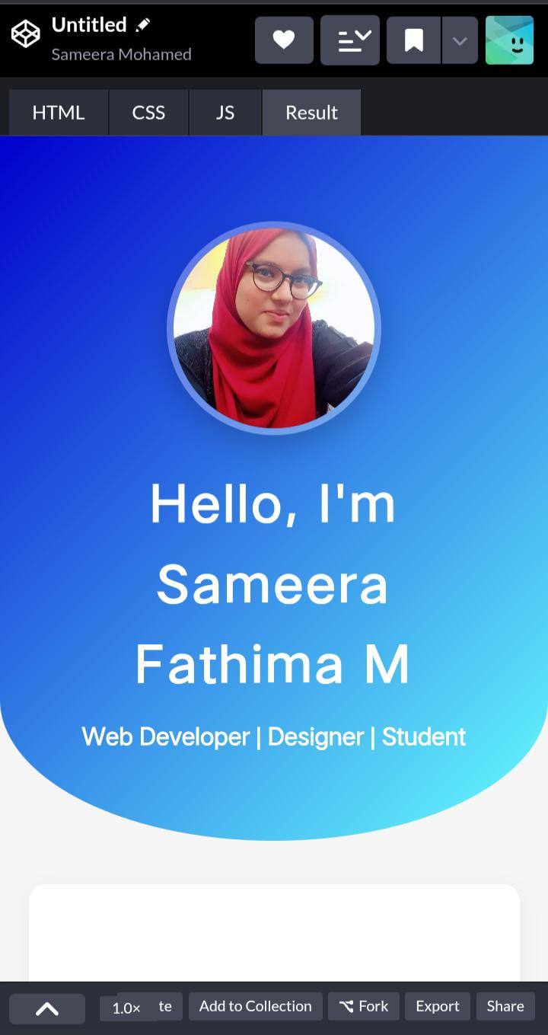

RESULTS AND SCREENSHOTS
The result of a digital portfolio is a professional online presence that effectively showcases your skills, experience, and accomplishments, leading to increased visibility, credibility, and new opportunities. A well-crafted digital portfolio can attract potential employers, clients, or collaborators, and establish you as a strong professional in your field. By highlighting your strengths and achievements, you can differentiate yourself and achieve your career goals.
3/21/2024 Annual Review
10

Slide 11
CONCLUSION
In conclusion, a digital portfolio is a powerful tool for showcasing skills, experience, and accomplishments in a visually appealing and easily accessible format. By carefully curating projects, designing an intuitive layout, and incorporating key features and functionalities, a digital portfolio can effectively demonstrate expertise and adaptability to potential employers, clients, and collaborators. A well-crafted digital portfolio can open doors to new opportunities, facilitate professional growth, and establish a strong online presence in today's digital landscape.
11

